Slide 1
Mobile and Web Game Monetization
Course : Mobile and Web Game Programming
Effective Period : September 2018

Slide 2
These slides have been adapted from: Dr Penny de Byl. 2014. Holistic Mobile Game Development with Unity. FOCAL. Burlington. ISBN:978-0415839235 Chapter 8 and Luton, W. (2014). Free-To-Play. Making Money From Games You Give Away. New Riders Chapter 3
Acknowledgement

Slide 3
Learning Objectives
LO 1 : Apply best practices of mobile and web game development
LO 2 : Apply game design and marketing techniques to boost mobile game performance
LO 3 : Produce game in mobile and web platform
LO 4 : Design game monetization and business model

Slide 4
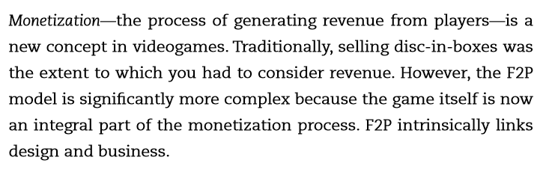
MONETIZATION?

Slide 5
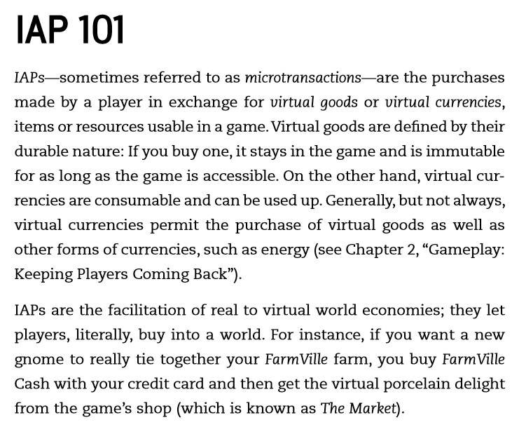

Slide 6
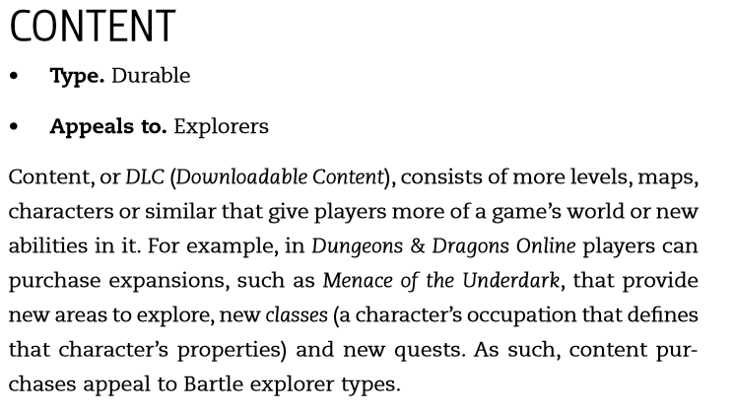
The 4 C’s of IAP

Slide 7
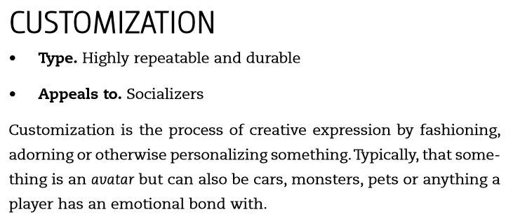
The 4 C’s of IAP

Slide 8
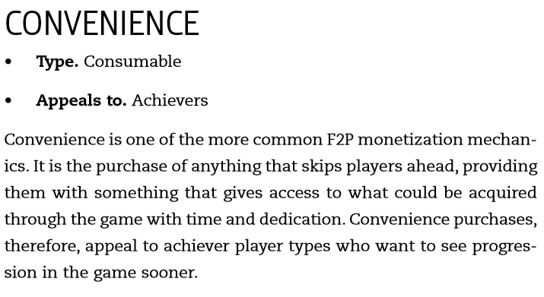
The 4 C’s of IAP

Slide 9
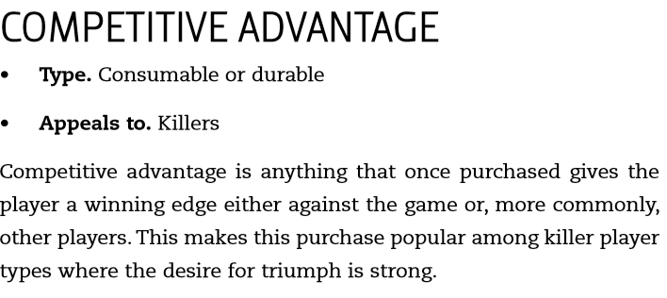
The 4 C’s of IAP

Slide 10
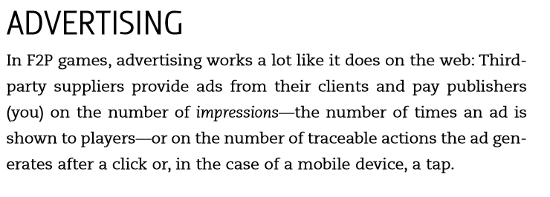
Beyond IAPS

Slide 11
Beyond IAPS

Slide 12
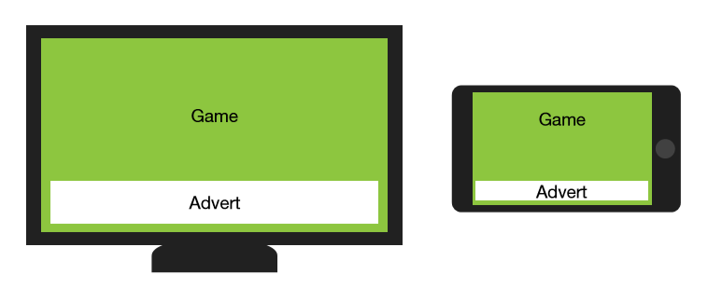
Advertising
Banner Ads
Image source:
Luton, W. (2014). Free-To-Play. Making Money From Games You Give Away. New Riders

Slide 13
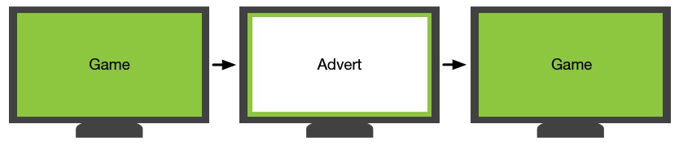
Advertising
Interstitial Ads
Image source:
Luton, W. (2014). Free-To-Play. Making Money From Games You Give Away. New Riders

Slide 14
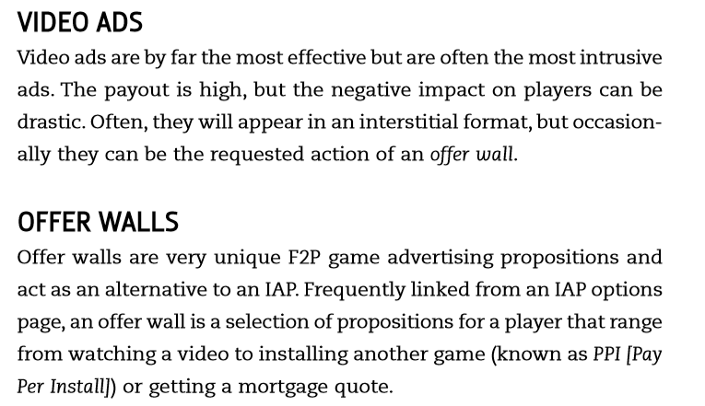
Advertising

Slide 15
References
Fullerton, Tracy. (2008). GAME DESIGN WORKSHOP: A Playcentric Approach to Creating Innovative Games. Morgan Kaufman ISBN 978-0-240-80974-8
Luton, W. (2014). Free-To-Play. Making Money From Games You Give Away. New Riders

